Slide 1

Cyber Fraud Awareness
Presented by: Bruce Phillips, SVP, Chief Information Security Officer
Mickey Vandenberg, SVP, National Escrow Administrator Williston Financial Group

Slide 2
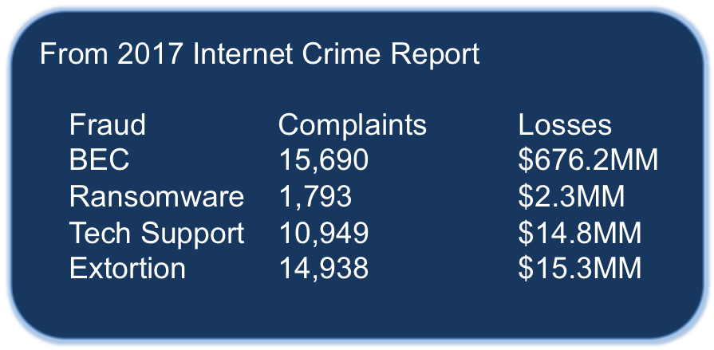
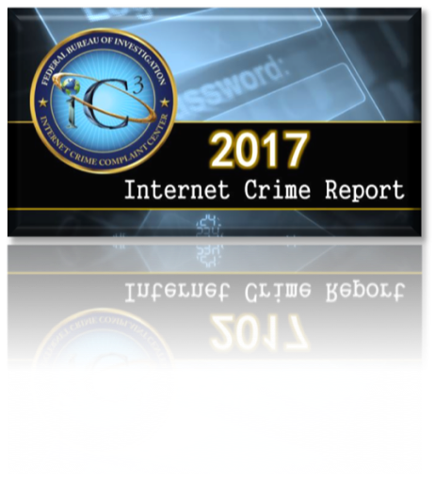

Notes:
2016
Fraud Complaints Losses
BEC 12,005 $360MM +88%
Ransomware 2,673 $2.4MM - 5%
Tech Support 10,580 $7.8MM +90%
Extortion 17,146 $15.0MM +2%

Slide 3


Hacking Tools & Services |  | Information for Sale
Password Stealer | $50 | US PII | $40 - $200
WordPress Exploit | $100 | Banking Credentials | $100 - $1,000
Account Hack (Facebook, Twitter) | $12.99 | ATM Card with PIN | $100 - $500
Hacking Tutorials | $5 - $50 | Credit Card w/Track Data (US) | $25 - $50

Slide 4
Bain Case Agent and Broker Liable for 85% of Wire Fraud Loss
[Plaintiff] is granted judgment against defendants [broker and agent], jointly and severally, on his claim for negligent misrepresentation in the amount of $167,129.27…
Bain v. Platinum Realty LLC et al., Case No. 16-CV-02326-JWL, Dist. Court, D. Kansas, 2018

Slide 5
O’Neill Case Bank not liable for failing to stop a $580K wire transfer to fraudster
Any duty [the bank] owed to [the law firm] was a contractual duty…not a duty based on social policy. Thus, [the law firm] may not recast their breach of contract claims against [the bank] as a tort-based claim.
O’Neill, Bragg & Staffin, P.C. v. Bank of America Corp., Case No. 18-2109, Dist. Court, E.D. Pennsylvania, 2018

Slide 6
Closing Agents and “Reasonable Care”
“In managing the Closing, reasonable care of a closing agent includes undertaking steps to protect [Consumers] from reasonable harm... The Wire Scam was a foreseeable harm...
- Wisconsin, March 2018

Slide 7
Title Company Failure to Safeguard
[Title company] breached its duty to use reasonable care in managing the closing by... failing to institute verification safeguards in delivering wiring instructions....
- Wisconsin, March 2018

Slide 8
All Industry Participants on “Notice”
Thus, the real estate industry, and [the bank, mortgage lender, title company, real estate brokerage and real estate agent] named in this action, were well aware of the presence of the wire fraud scam, the risks associated with sending confidential information over unsecure channels, and the steps that must be taken to ensure that consumers would not be victimized by that scam.
- Colorado, June 2017

Slide 9
Closing Attorney Breached “Fiduciary Duty”
[The closing attorney] had a fiduciary duty to protect the [buyers’] interests. This duty required her to adopt reasonable and necessary measures to safeguard her email account and computer system against intrusion from cybercriminals.
- New York, April 2016

Slide 10


Don’t Trust email
Use multi-factor authentication for web-based email
Change your email password
Use encrypted email when sending sensitive information
SSNs, wire instructions, etc.
Protect Your Web Site
Attackers can use it to target your customers
Make sure it is built and maintained securely

Slide 11


Keep Your Computers and Phones Up To Date
Patch religiously
Use Firewalls, on Your Computer and Internet Connection
Use Commercial Anti-Virus Software
Update A/V signatures daily
Notes:
Keep Your Computers and Phones Up To Date
Patch religiously
Use Firewalls, on Your Computer and Internet Connection
Use Commercial Anti-Virus Software
Update daily

Slide 12


Take Aways
Attackers know what you do
They want money
Playbooks are for sale on the dark web
Email is the attackers favorite tool
Notes:
Attackers know what you do
They want the escrow funds you control
Playbooks are for sale on the darknet
Email is the attackers favorite tool

Slide 13


Steps to manage cyber fraud prevention
Review your policies and procedures to make sure cyber fraud is adequately addressed
Review and test your security and encryption technology
Train your employees on a regular basis on cyber fraud
Trust but verify
Notes:
Mickey

Slide 14


Outgoing wire procedures
Wire Instructions must be notarized and include contact phone number and email address
All wire instructions must be verbally verified at a known number for the recipient prior to sending the wire

Slide 15
International outgoing wire procedures
Separate procedure for International wires
Accounting to send out international wires
Wire instructions must be notarized before a company approved notary
Manager must review, verify wire instructions and sign off on wire

Slide 16


Incoming Wire Instructions
Avoid using email for incoming wire instructions
Educate your customers at opening about your wire instructions process
Never send wire instructions to any party other than the party sending you money

Slide 17


Communication is key
Talk to your real estate agents
Talk to your lenders
Talk to your buyers and sellers

Slide 18

When fraud happens
Have a specific Procedure and a designated spokes person
Contact Financial Institution immediately if your funds have been compromised
Tell the customer to contact their bank immediately if your customer was compromised
Contact local FBI as soon as possible
File Complaint at IC3.gov
Use lessons learned to update your policies and procedures and train your staff

Slide 19
Even when you do everything right….
WFG client wired $ to hacker
WFG personnel followed appropriate steps to avoid cyber fraud
WFG client was taken in by email that from gmail account
WFG portrayed as the villain by media
Media(TV, Radio, Press)

Slide 20

Thank You
Bruce Phillips SVP, Chief Information Security Officer
Mickey Vandenberg SVP, National Escrow Administrator

